Slide 1

Diabetes-related disparities in health care use
Progress Update
2/28/20
Illustration by Sabogal, Diego, and Ruth Basagoitia “Diabetes: Facts, Statistics, and You.” Healthline, Healthline Media, 1 June 2018,

Slide 2
Progress
Have generated counts and proportions of visits by Age, Sex, Rural/Urban, Region, and Insurance among the National Emergency Department Dataset
Have nearly completed updating the protocol for analysis by diabetes status to be sent to Gail

Slide 3
Analysis – AIM1
Retrospective, serial cross-sectional design: yrs 2008, 2011, 2014, 2016
Estimating rates of Inpatient and Emergency Department Use among people with Diabetes
First conducted nationally, then at the state level (each state individually, starting with revisit-states)
Aim to have tables for Aim 1 analysis by April 6th for delivery to Merck
Essentially repeating analysis done with MEPS, but with data available at state-level and more observations
Generating Inpatient and ED rates
Stratify by Age, Sex, Race, Rural/Urban, Region, Insurance Provider, Hospital Teaching Status
Beginning with National Emergency Department data using NEDS

Slide 4
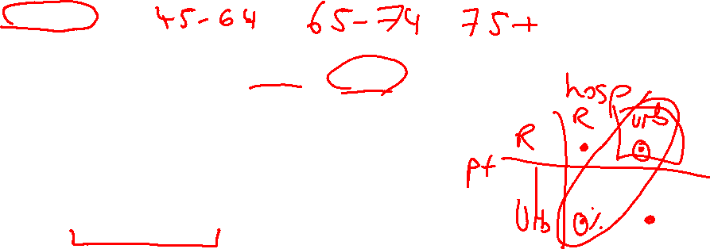
Diabetes-related Visits and variables
Have identified all visits with any ICD code listed as
ICD-9: 250
ICD-10: E10, E11, or E13
Capped to first 5 discharge diagnoses
National Analysis:
Age groups: 18-29, 30-44, 45-59, 60-74, 75+
Should we keep to these groups?
Disposition information for ED as follows: Admitted, Transfer, Routine, and Other
No information on Clinical Decision Units at national level
Rural/Urban: Urban as “Metro or Micropolitan”, Rural as “Not Metro or Micropolitan”
Defined by patient location
Region: Region defined by region of hospital
Insurance defined by primary payer: Medicare, Medicaid, Private, Self-pay, or Other for event

Slide 5
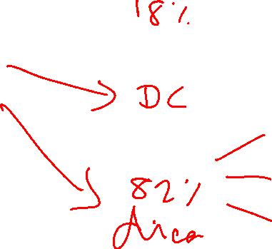
Counts and proportions (2011) for NEDS
DM-related
Admitted
CVD/CKD/Neuropathy
ED
Non-DM
Go home

Slide 6
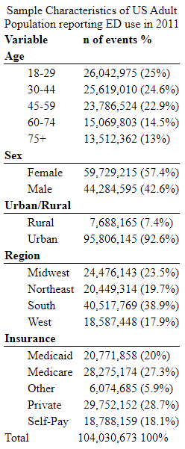
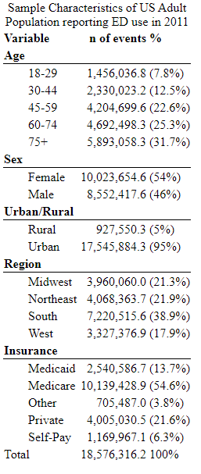
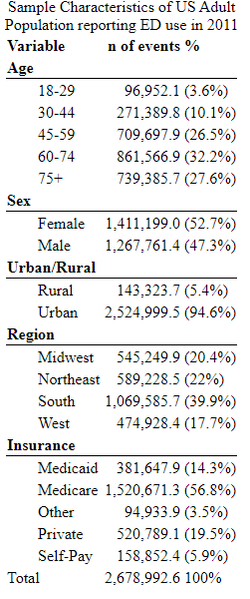

Counts and proportions (2011) for NEDS
DM-admitted
Admitted
Next step is to stratify by
DM-related,
Diabetes Complications,
And Non-DM diagnoses
ED

Slide 7
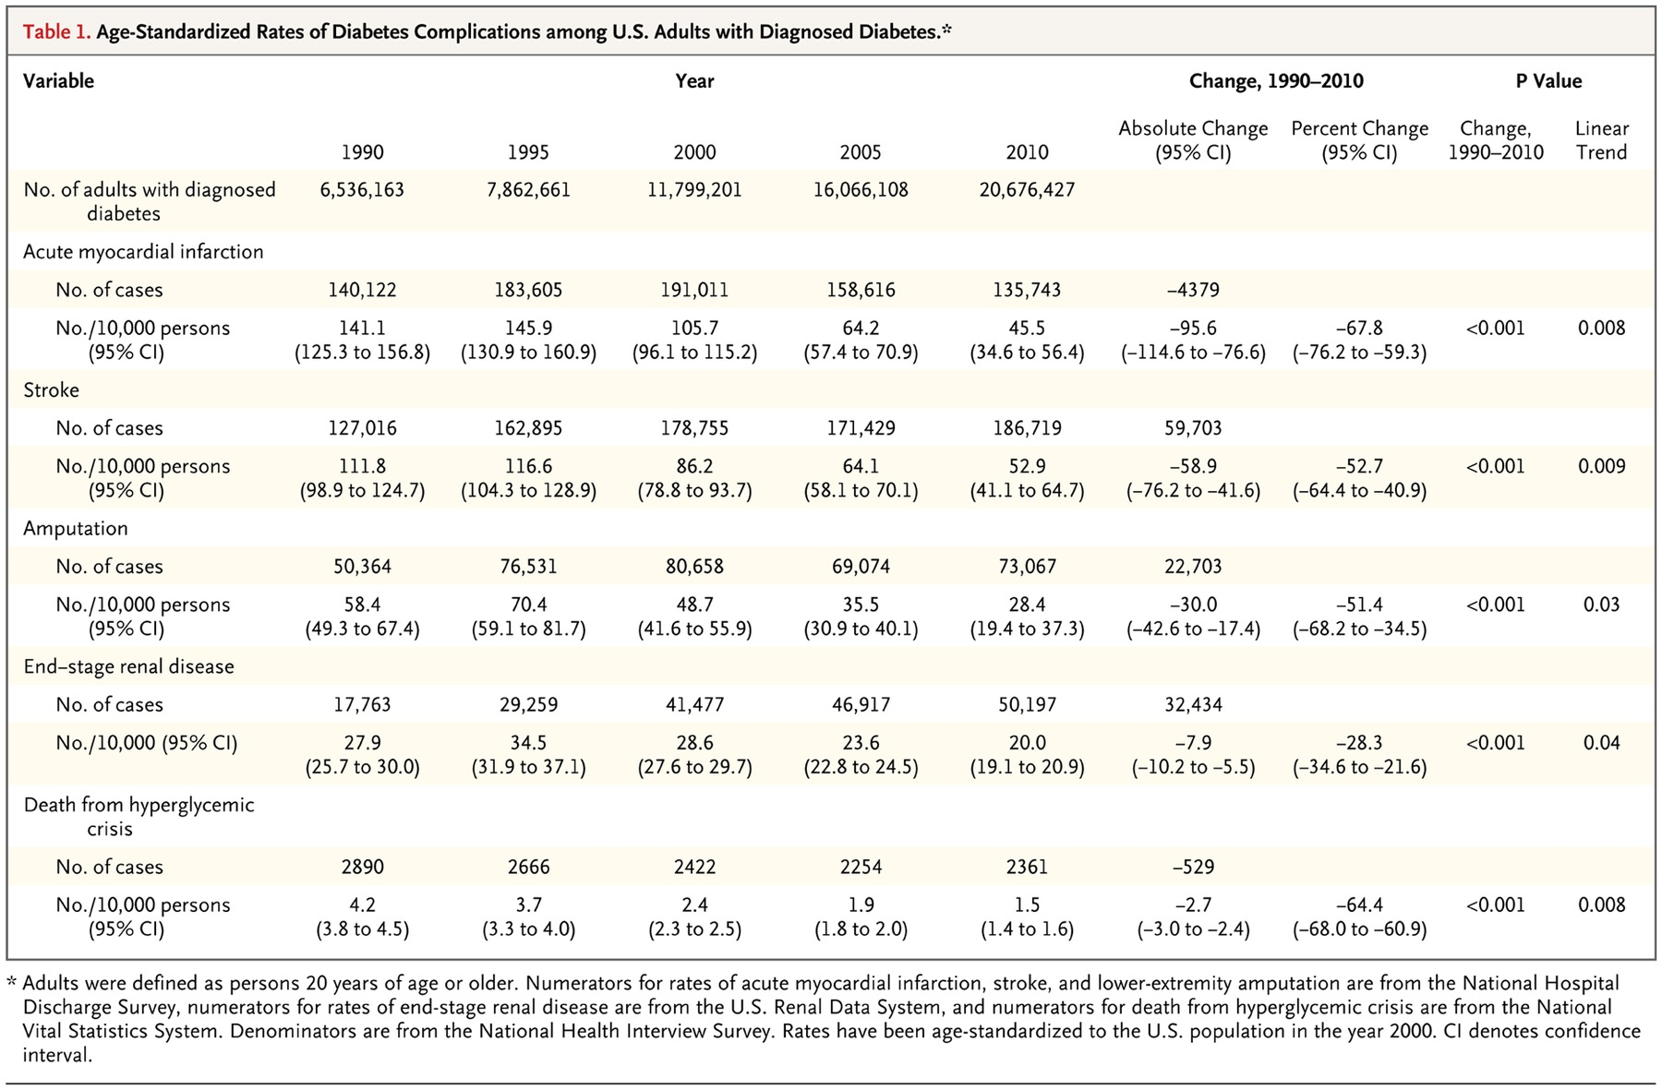

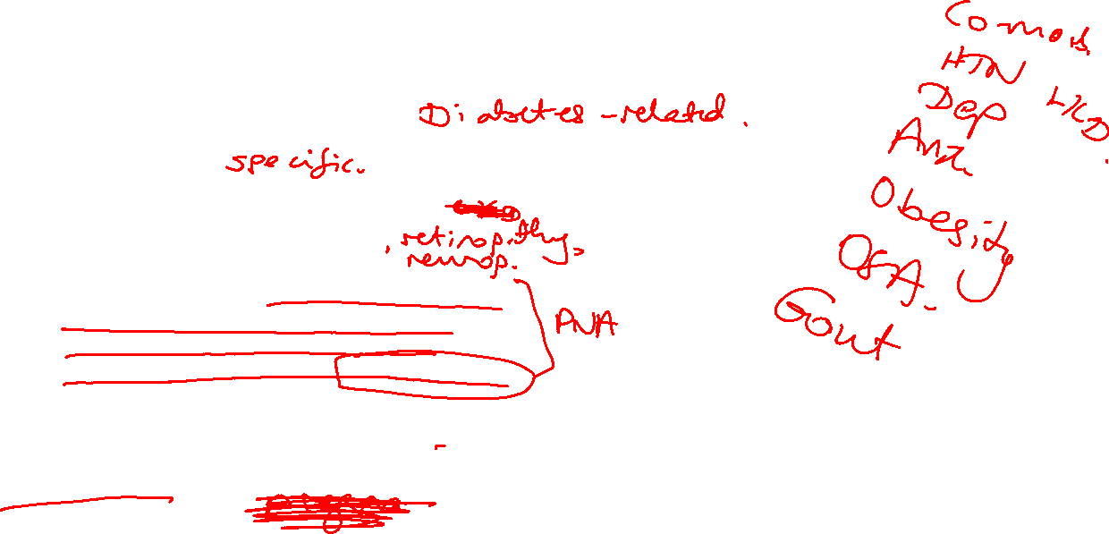
Counts and proportions (2011) for NEDS
Next step is to find # and prop of visits with
Diabetes Complications:
Ketoacidosis, DM coma/hyperosmolarity, uncontrolled DM, Lower Extremity Amputations/Ulcers/ Inflammation/infections, Hypoglycemia
Diabetes Comorbidities:
Retinopathy, Neuropathy, Acute Coronary Syndrome, Acute Myocardial Infarction, Angina, Arrythmia, CABG/Claudication, Heart Failure, Peripheral Arterial/Vascular Disease, Stroke, Depression/Anxiety
Non-DM diagnoses:
ICD-codes indicative of traumatic episode, including Injuries, Poison, Toxic effect of Drugs, Burns, Trauma (could use Major Diagnostic Category Codes)
Depression?
Gregg, Edward W., et al. “Changes in Diabetes-Related Complications in the
United States, 1990–2010: NEJM.” New England Journal of Medicine, 17 July 2014,

Slide 8
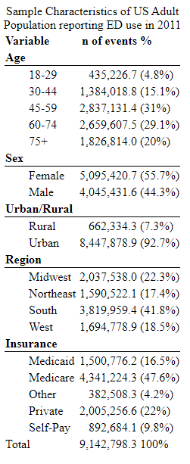

ALL diabetes visits to the ED
and those DM-admitted:

Slide 9

Non-Dm study population
Non-DM population was defined in MEPs as missing all of the three criteria we used
Self- report, prescription for DM medication, or health care event for DM
With HCUP, we can use discharge diagnoses to define Non-DM population
Instead of keeping to the top 5, should we expand to largest possible
(i.e. if patient has DM in diagnosis 15, they still have DM)

Slide 10
Next Steps
Finish protocol changes, send to Gail
Add variables and find estimates based on type of admission (DM-related, DM-complications, or Non-DM) and Hospital Teaching Status
Calculate age and sex adjusted rates for emergency department use in national datasets
Repeat with national inpatient data, then with the four revisit-states

